Slide 1
Clinic
Management
System
Mariam Hesham – Sandra Faris Nour Ahmed – Samiha Hesham

Slide 2
Dr Ahmed Ghoniem clinic

Slide 3
Agenda
01
Introduction
The main purpose of this project ,The scope , The overview and the Business Context .
02
General description
Product Functions, Product context , Similar System Information , User Characteristics and User Problem Statement
03
System Requirements
Functional Requirements , Non-Functional requirements and Interface requirements
04
Diagrams
Use-case diagram , Context diagram, Block diagram , Class diagram and ER diagram, Database Diagram.
05
Operational Scenarios
Login and Registration System , Appointment System , Chatting System , Operation System and Administrator System

Slide 4

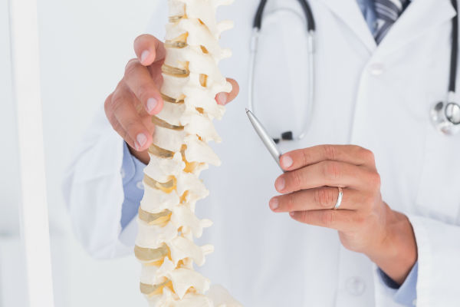
Purpose
The main purpose is to clarify the requirements of a Clinic System. These requirements include booking appointments, contacting Doctors or Physician assistants, and viewing patients' medical information. Our aim is to assist patients' to reserve appointments and reach out to healthcare professionals easily. Moreover, our system shall make it easier for Doctors to view patients' medical information, in order to provide accurate diagnosis.
INTRODUCTION
Scope
The scope is to break down our client's problems into chunks that can be solved more readily. It also helps to increase understanding of issues and makes them easier to be tackled through our system and tested properly to full the optimum solutions.

Slide 5
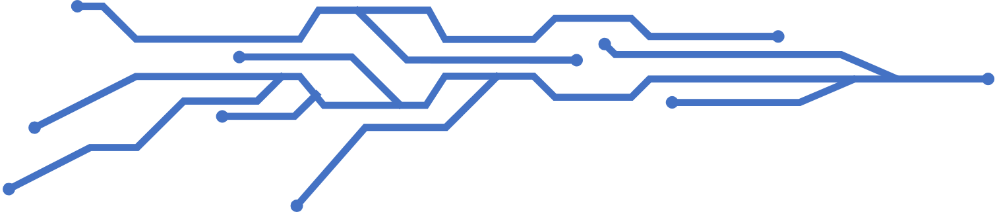
overview
INTRODUCTION
The project clinic management is developed to facilitate the communication process between the doctor, the receptionist, the assistant and the patient. The software would be managed by two admins one is doctor and the other is receptionist. The doctor can view patient details and after checking up the patient, the recommended medicines for the patient are fed into the database by the doctor and are sent to the receptionist. The patient can book an appointment and state the medical history .Receptionist would be responsible for viewing appointments and save it in the database along with their details .The receptionist can then generate bill and feed into the database. The system also maintains patient's history so that doctor or assistant can view them anytime .The assistant would be responsible for booking an operation and follow up with the patient after the surgery .The system can thus reduce complexity in maintaining patient's records.

Slide 6
Business
INTRODUCTION
context
The project aims to build an application program to reduce the manual work for managing the clinic. According to Cheah Ming Lay's article on Clinic management systems[3], The systems help to end the complexities involved in accounting. The system can provide convenient access to information and making it less likely that mistakes would be made due to illegible writing. It improves the ability to remotely access the data and making it easier to maintain and quicker to search through for relevant.

Slide 7
Product Functions
The system must be fully dynamic ,in which the admin is fully controlling
the system.
The doctor should have the ability to write a report to the patient's case
with all details.
The users (patient ,doctor ,receptionists ,assistants) must be able to control their information
The doctor must be able to reserve operation for the patient if needed.
The patient must be able to reserve his/her appointment online and choose
either paying online or cash.
The assistant must organize the doctor's schedule and add ,edit or delete
operations to it.
The system should be able to send automatic emails and SMS to the
patients.
The assistant should perform a broadcast en-forming patients of any cancellation in the doctor's schedule.
The admin should have full authority to control all staff permissions.
The patients must have the authority to edit their appointment details.
The doctor must be able to see full information of the patient.
The receptionist must view patients' reservations and should deal with financial staff .

Slide 8
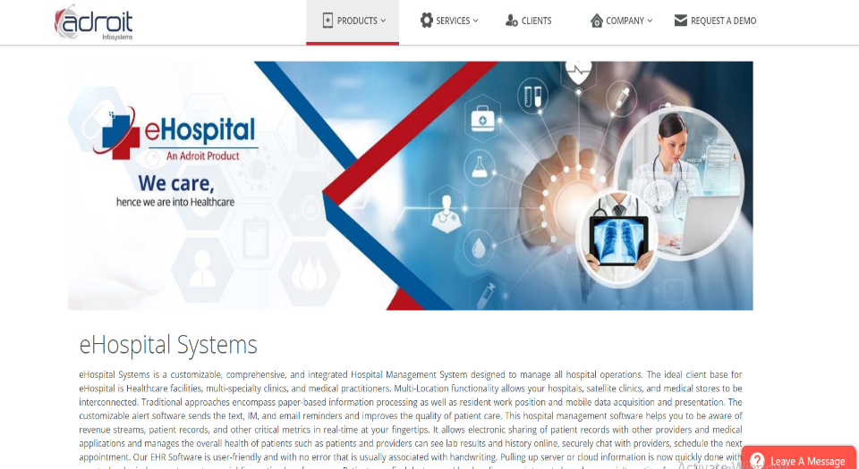
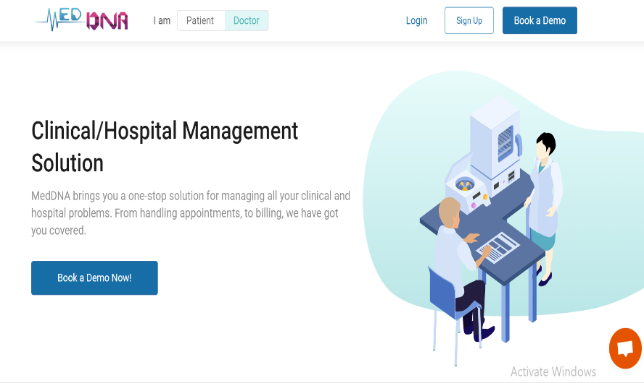
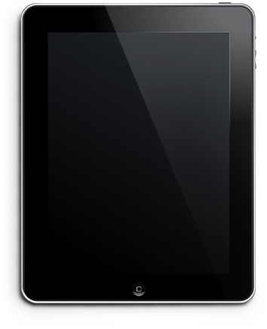
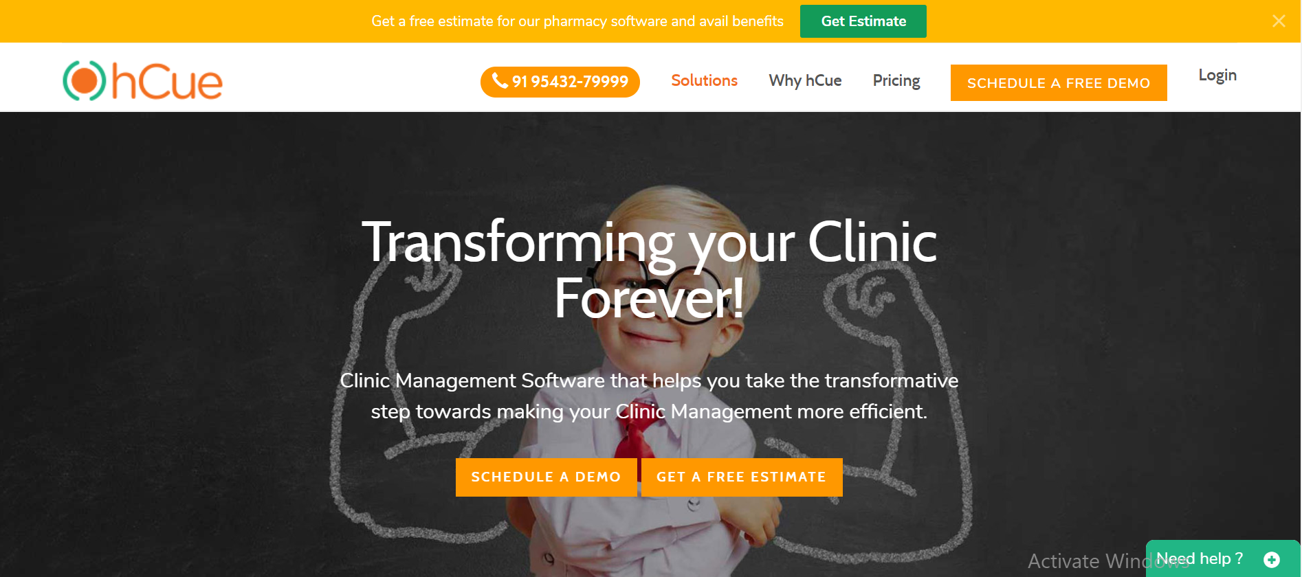
Similar System Information
This software is similar to various generic products. However, MedDNA [2] ,myhCue [5], and Adroit's eClinic [1] are the most similar to our system (Adriot Infosystems is a Healthcare IT company which produced various products, including eClinic). These systems are stand-alone clinic management systems that are available for installation by any customer in need. Their purpose is to help in managing appointments, viewing patients' history, and offering effortless communication between the Doctors and their Patients, just like our system is intended to do.
Adroit's eClinic
MedDNA
myhCue

Slide 9





User Characteristics
According to a Software Requirements Specification document written by Shiva Prasad [4] , there are four main users in the clinic management system. The admin, doctor, receptionists, and patients. However, in our system, we will have an additional user who is the doctor's assistant. The system is also designed to be user-friendly.
Admin
Receptionists
Doctor
Assistants
Casual users
Admin should have prior knowledge of the system. Admin is able to control the whole system. He/she can add, delete, update and modify the system.
in order view the details of the patients come for the treatment and accordingly provides identity to them also, schedule the appointments of the day and deals with payment methods.
Doctor should fairly know about the usage of the system. And are able to see the respective appointments taken. Also, can view patient's details and records and set for them operations if needed.
they are mainly managing the chatting system for the clinic with patients and they must view, edit ,delete and add operations in the doctor's schedule.
Anyone can view the information of the polyclinic. Patients can view their own records and doctor's details and timings to take appointment online.

Slide 10
User Problem Statement
Our client needs to replace all the manual operations done daily in his clinic into automated ones. Starting from patient's booking their appointments, saving their history to be easier to retrieve on the follow up day to booking surgeries too .Also they need a chatting system in order to facilitate patients contact with our client or his assistant .All of which should be easy to use , without any complexities to provide fast interactions without consuming time while dealing with our software.

Slide 11
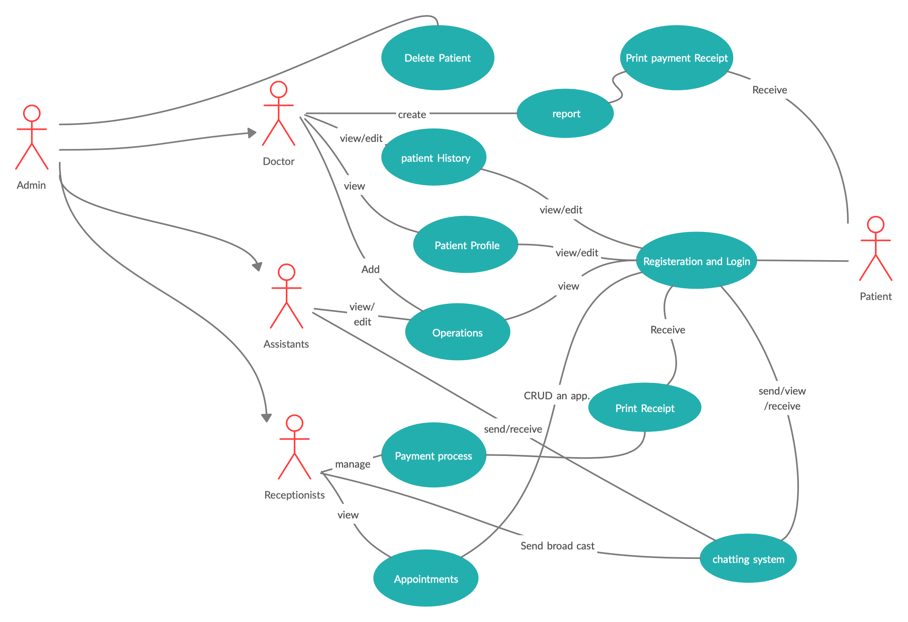
Use-Case Diagram
DIAGRAMS

Slide 12
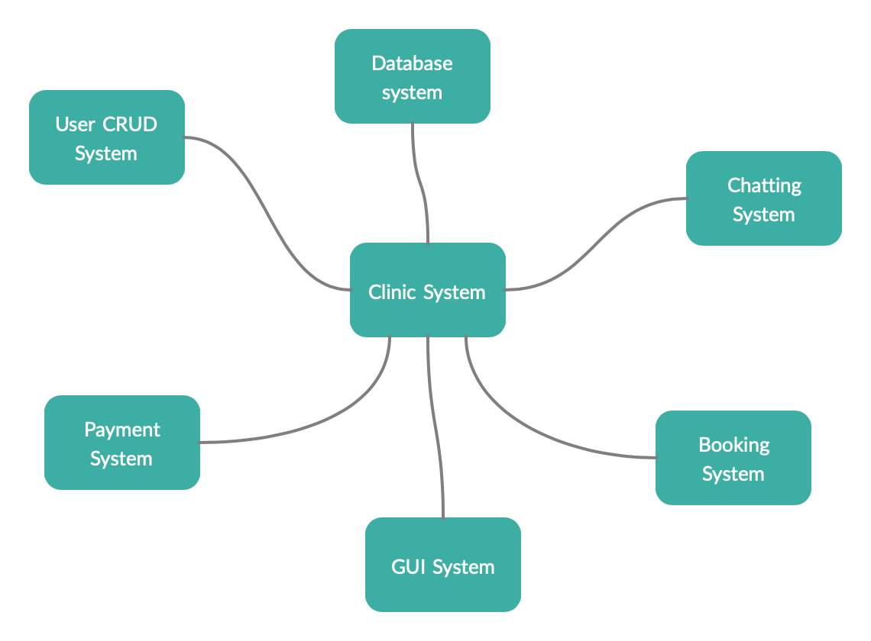
Context Diagram
DIAGRAMS

Slide 13
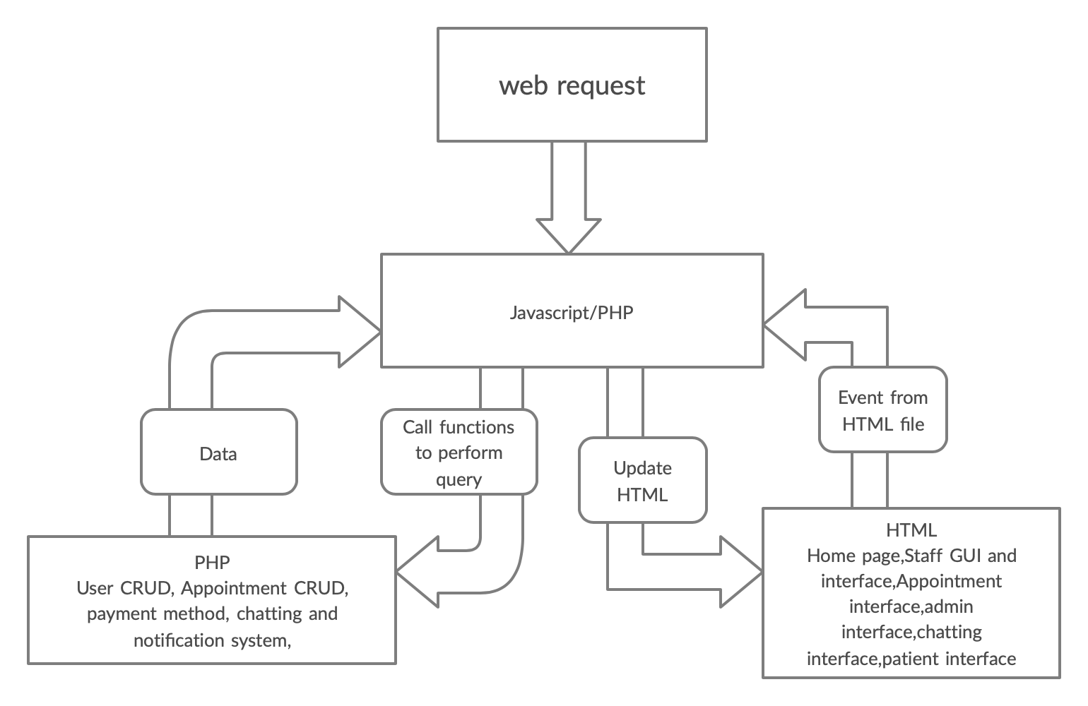
Block Diagram
DIAGRAMS

Slide 14
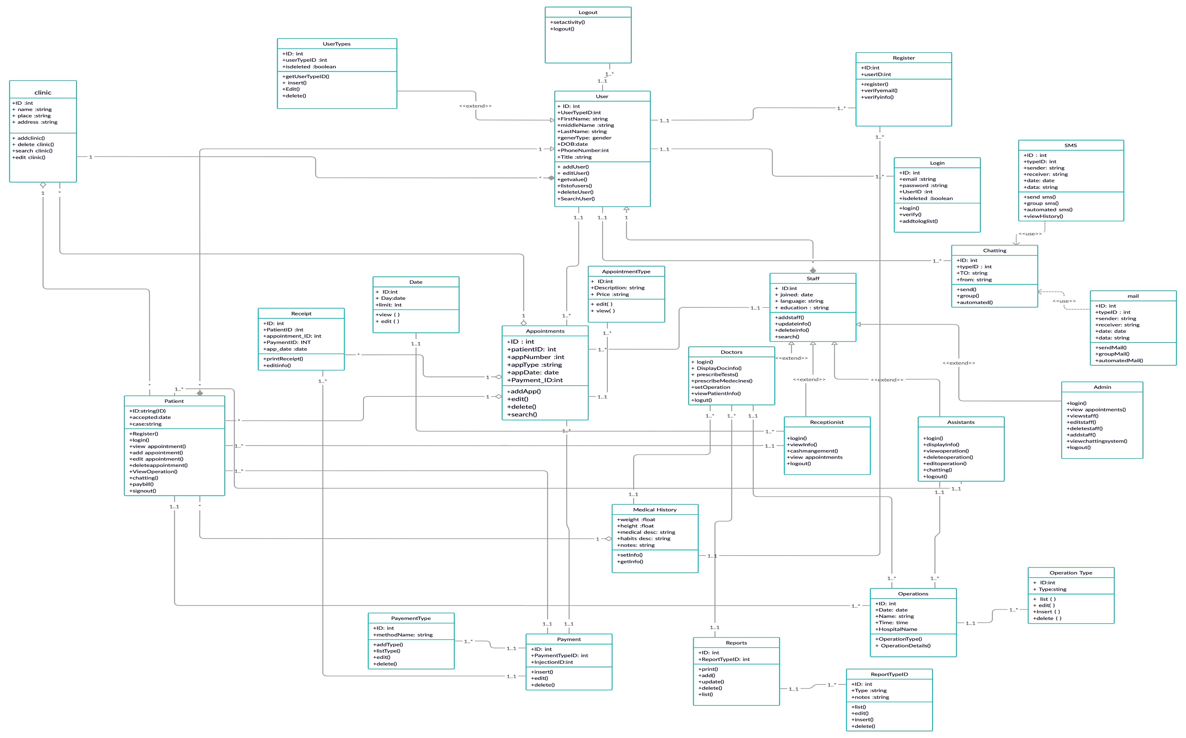
Class Diagram
DIAGRAMS

Slide 15
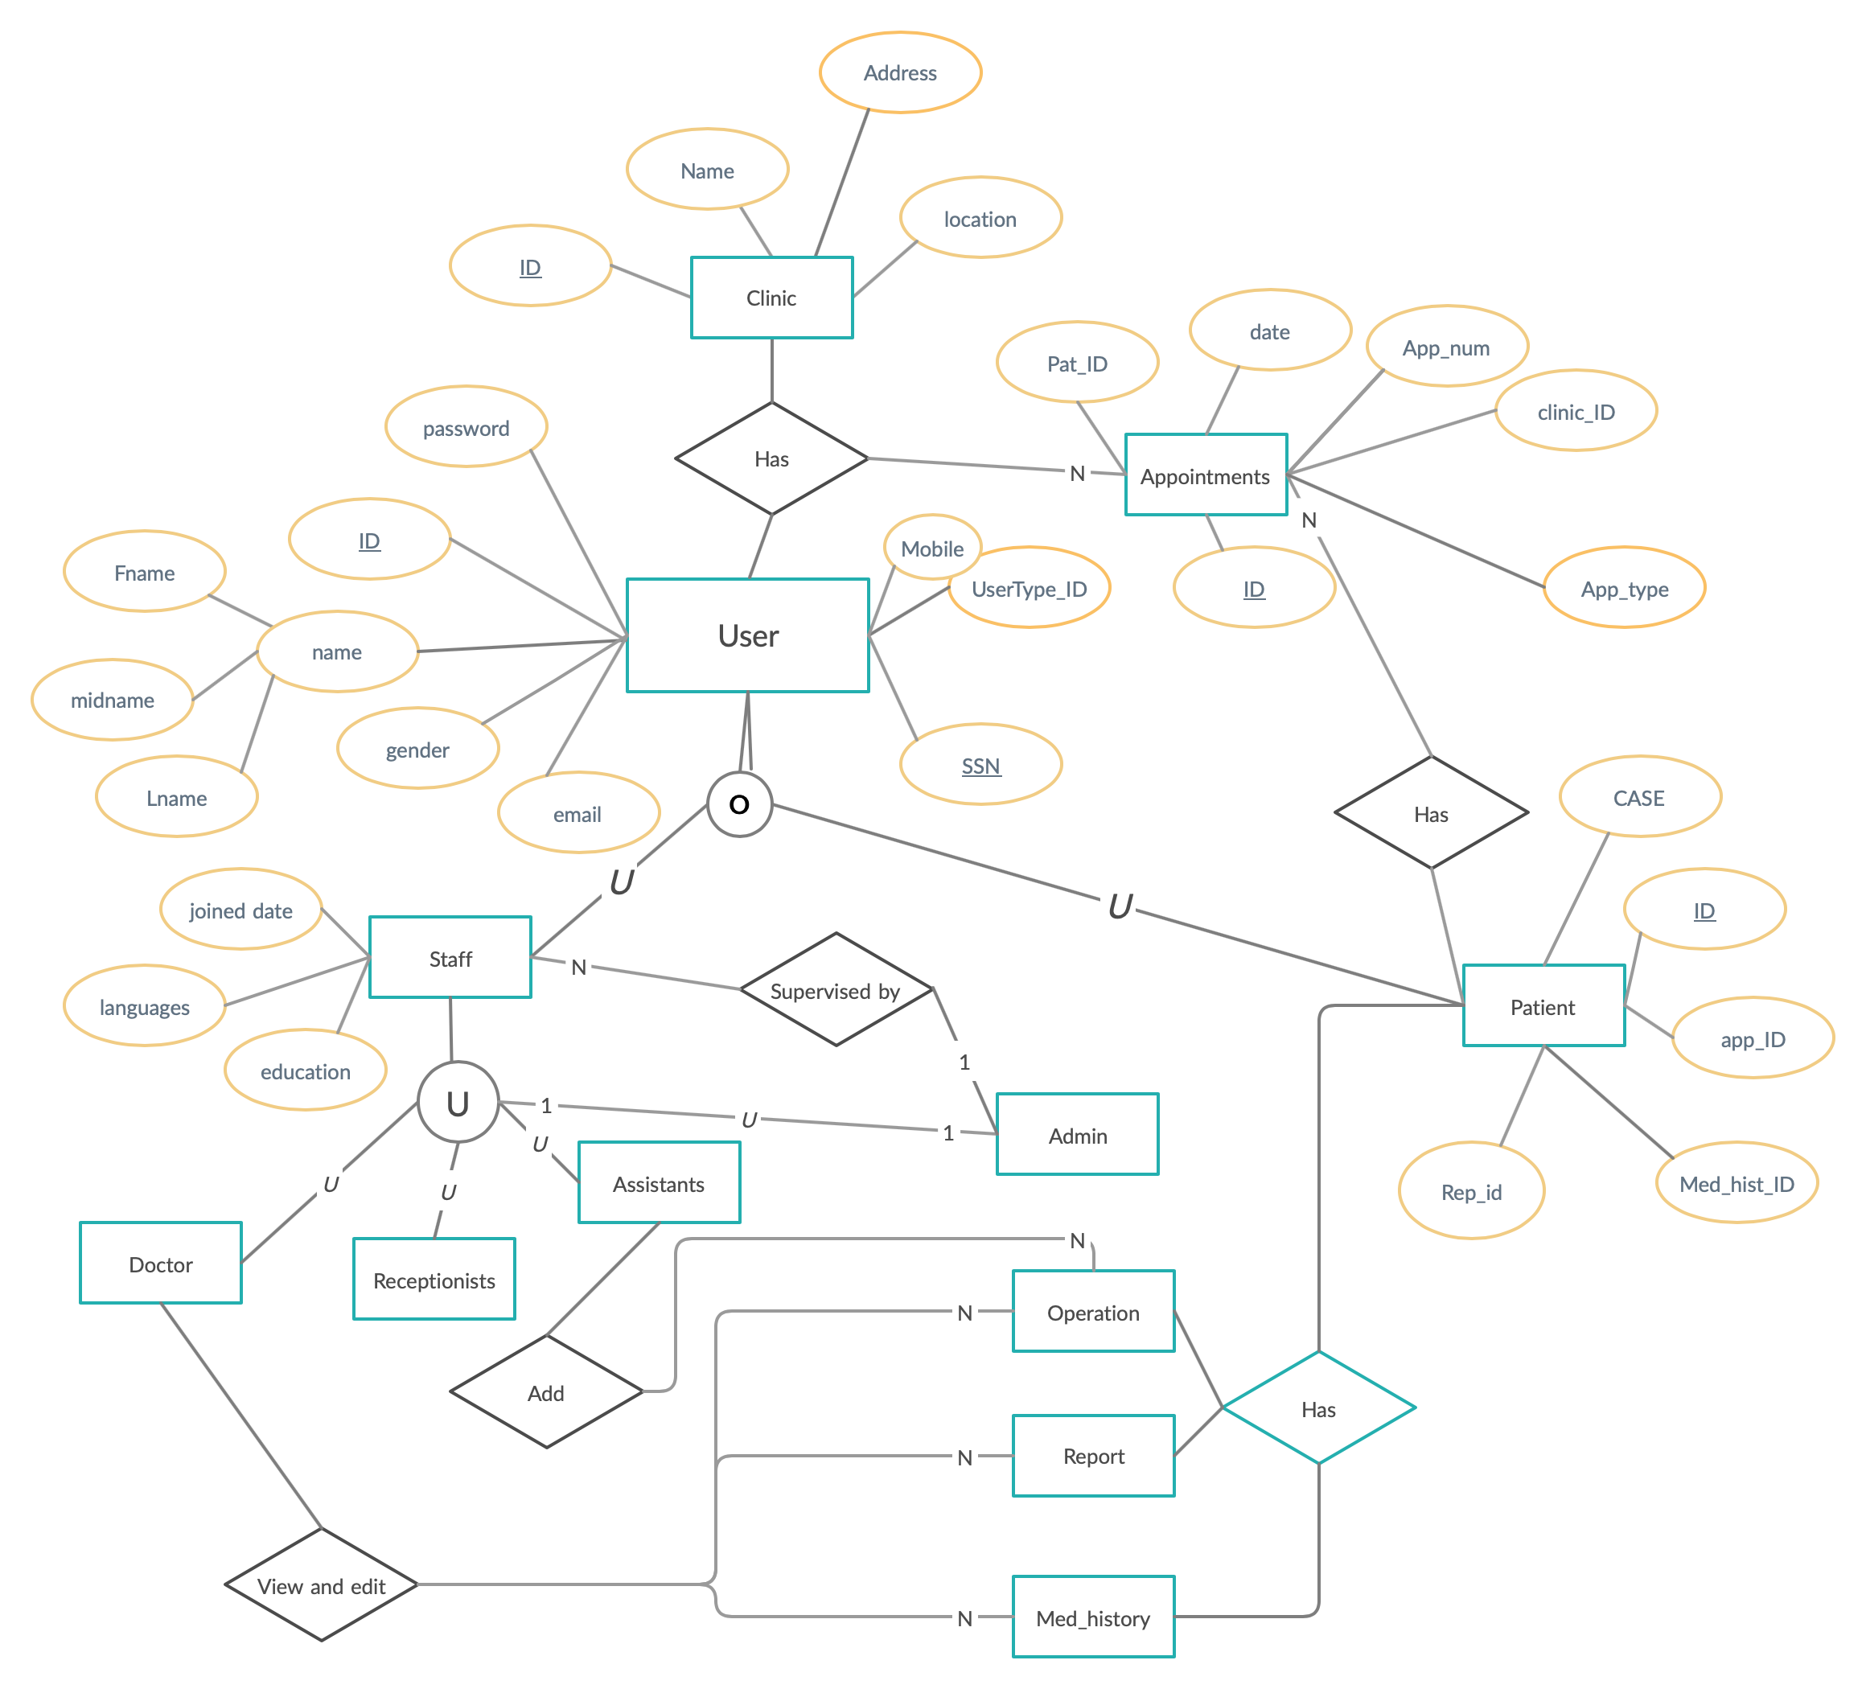
ER Diagram
DIAGRAMS

Slide 16
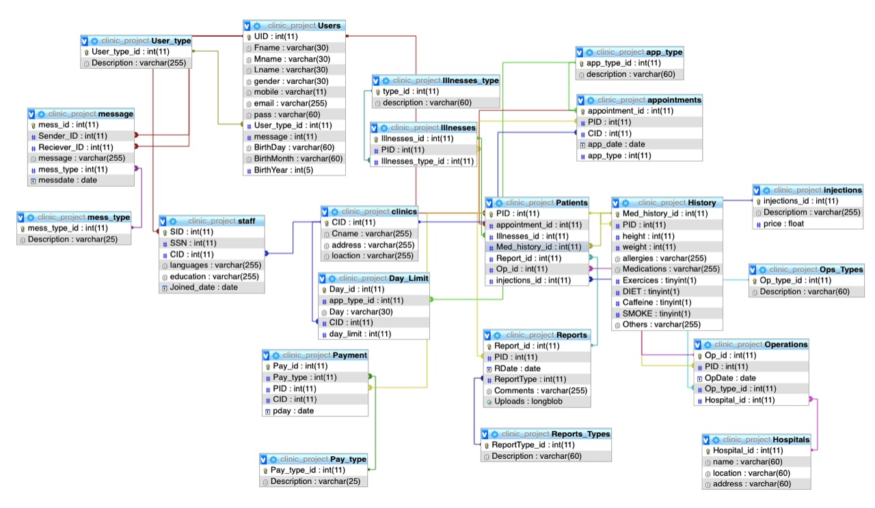
Database Diagram
DIAGRAMS

Slide 17
Functional Requirements
Login
Create User
View Profile
Add Appointment
This function is for the user to login into the system using his/her account..
The functions get the user type ID according from which page the inserting process
User can view his/her profile, admin can also view the profile.
This function adds a new record to the appointment table in the database
Create Report
Print Receipt
Add Operation
Send message.
This functions allows the Doctor to create or write reports to his patients if needed
This function prints a receipt for the patient of his booking
fee and injection fee, if he needed any.
This function adds an operation by getting the ID according to which operation is being inserted
The function for sending messages and chatting between the users

Slide 18
non-functional attributes
Security
This system is provided with authentication without which no user can pass .So only the legitimate users are allowed to use the application.
Reliability
Good validations of user inputs will be done to avoid incorrect storage of records..
Maintainability
The software system helps a lot in maintaining the software system, and minimize the amount of changes that will be done in the code
Portability
This system can be installed in any personal computers supporting windows operating system platform.
Flexibility
The system keeps on updating the data according to the transactions that takes
place.

Slide 19

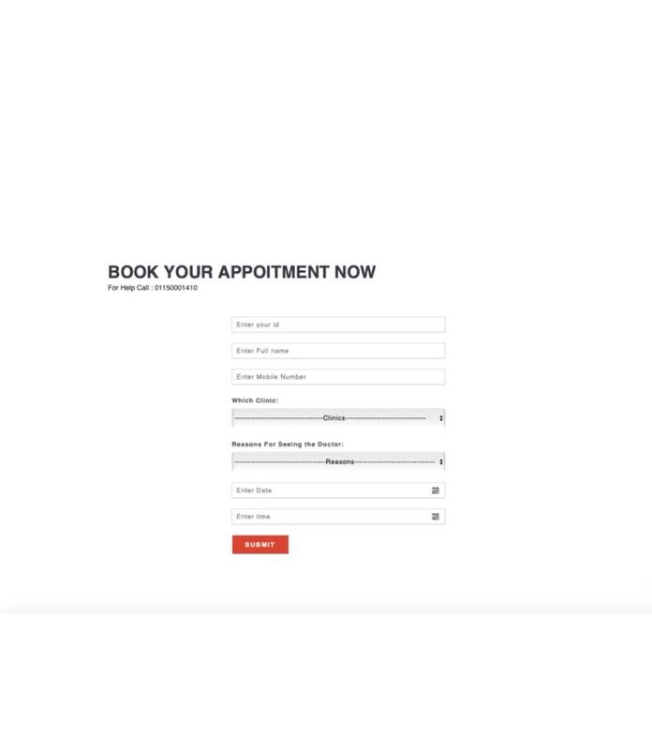
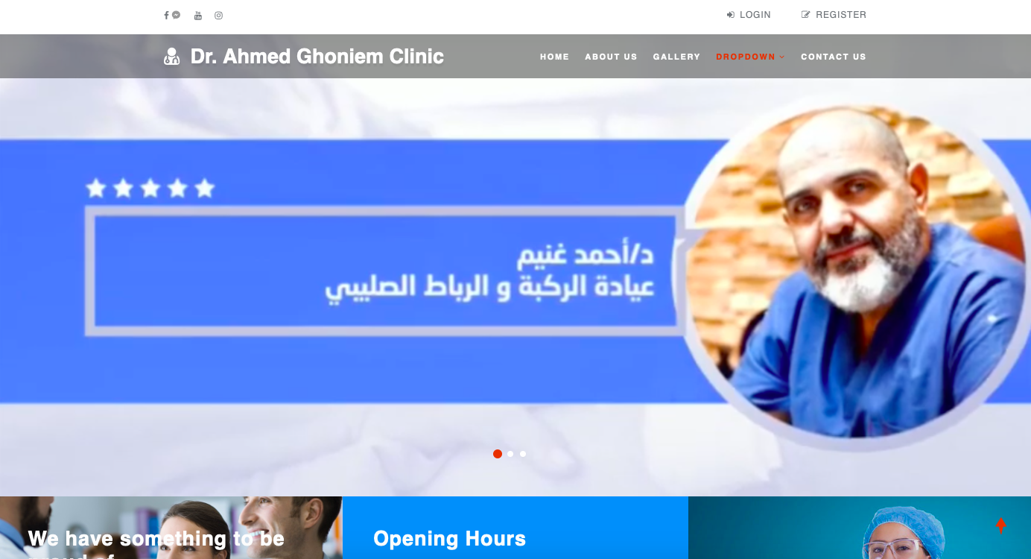
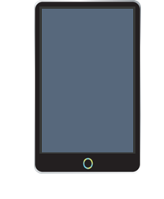
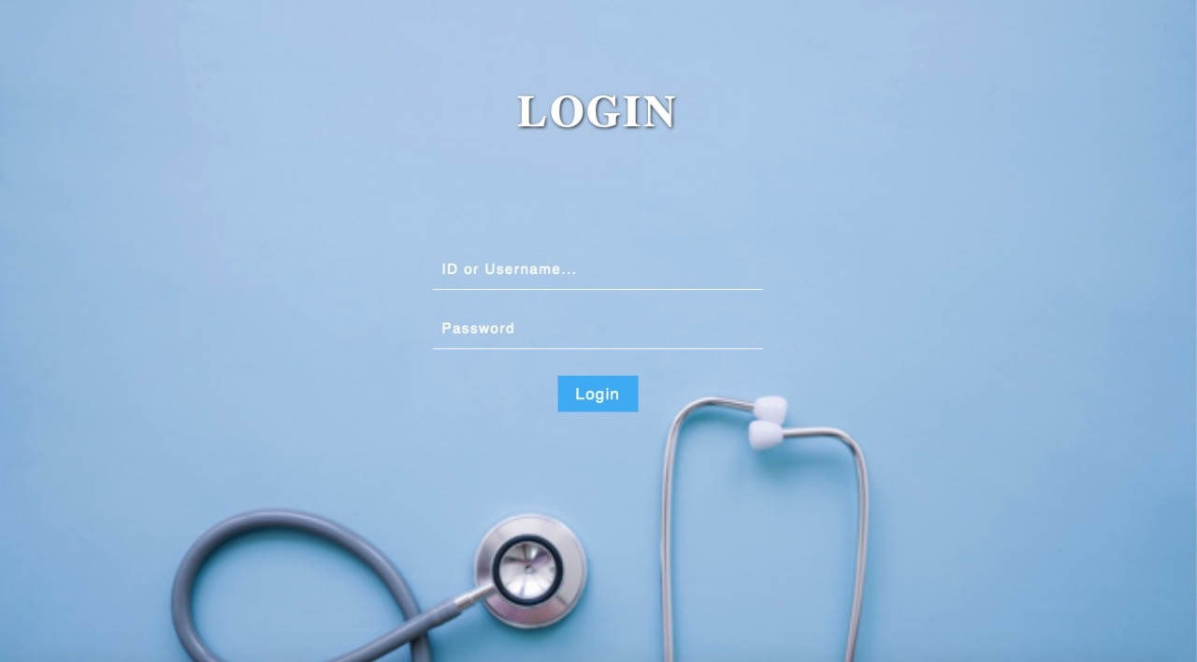
Interface Requirements
Booking Page
Main Page of website the patient use it
Staff's Login

Slide 20
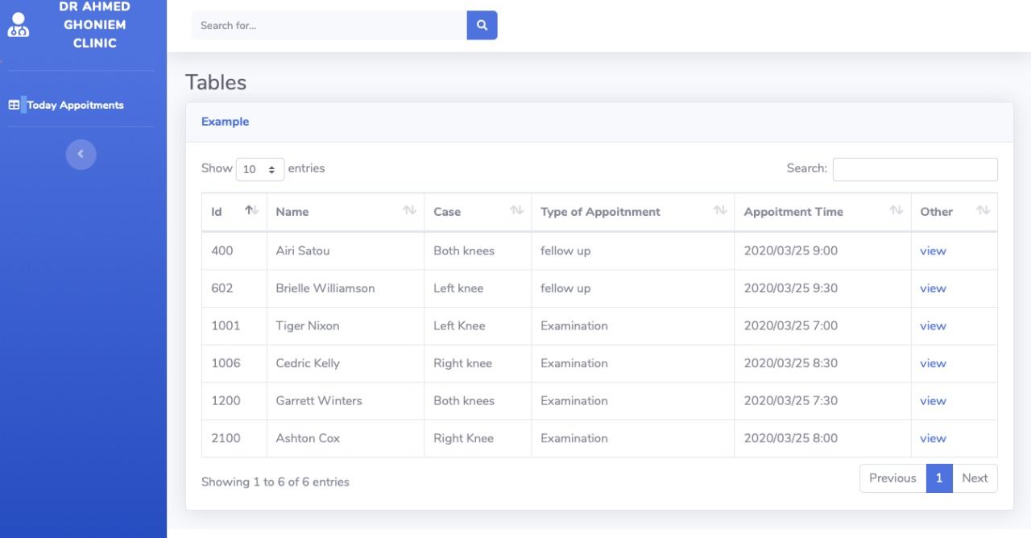
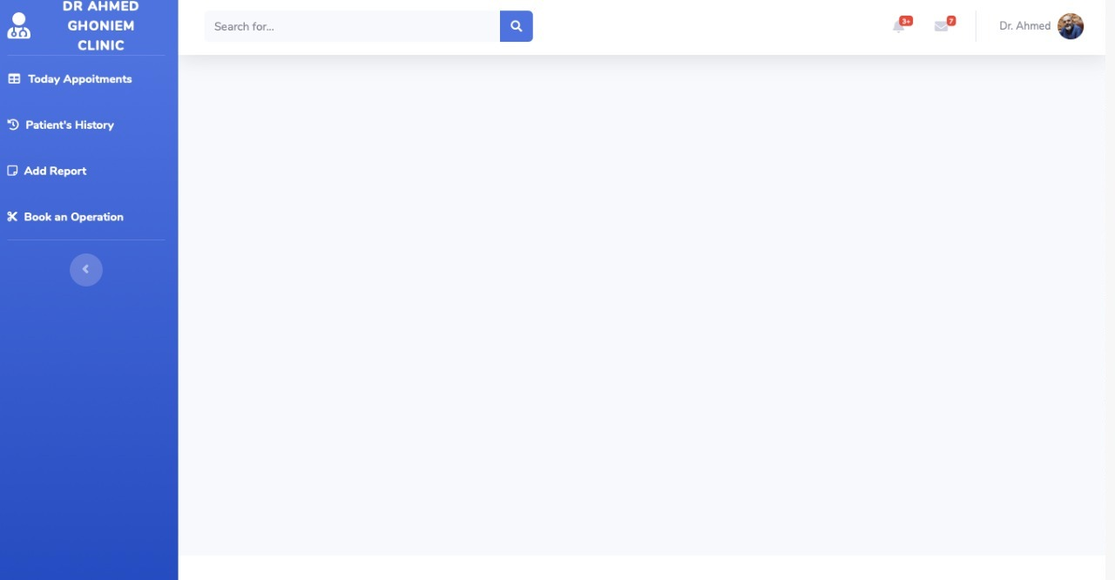
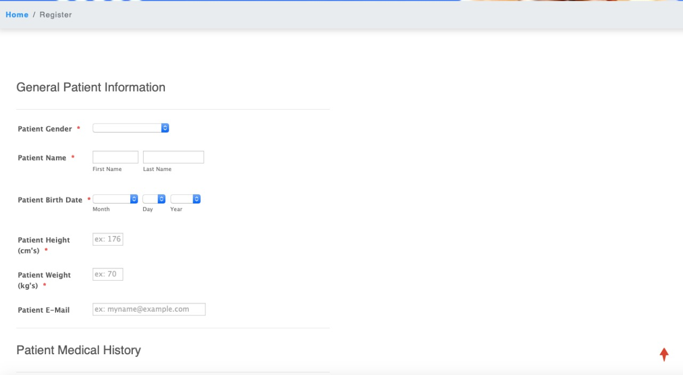
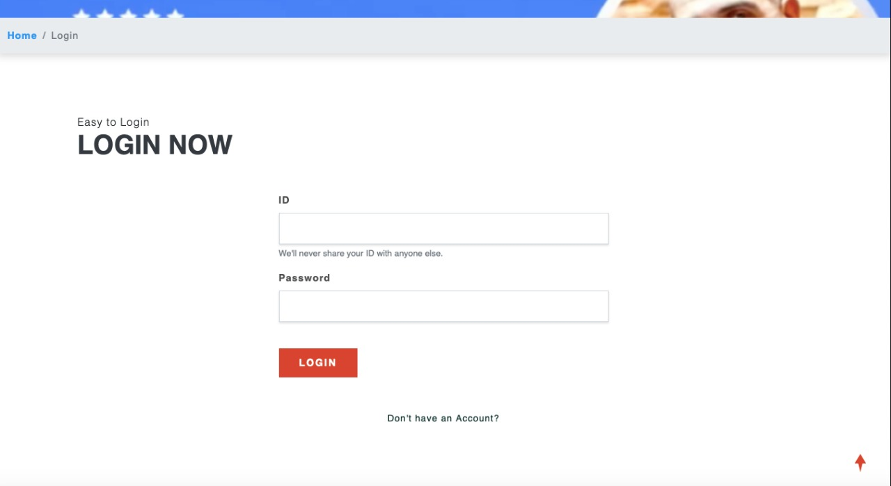
Interface Requirements
Appointment's Time Table Page
Doctor's dashboard
Registration page
Patient's login

Slide 21
Operational Scenarios
Login and Registration System
-Patients should view and edit their information including their medical description and personal habits -Doctor can view patient's information but only can edit their medical history and his reports.
Appointment System
A brief explanation for some of the scenarios that present in
our system
-Patients have the ability to choose the time of appointment they want to reserve . Moreover, they can edit or delete them and they can choose the branch(Location of the clinic) they want to book at. -Receptionists have the ability to see the appointment's schedule for everyday.
Chatting System
-Receptionists and assistants are responsible for managing the chatting system. -Patients can send message to the clinic and the assistant is responsible for handling it -Patients can view their history messages -Admin can select specific patients to broadcast the message to them. -Receptionists send notification to the patient to inform them if the doctor cancelled any reservations.
Operation System
-The doctor has the ability to add operation to the patient if needed -The assistant can view the operations and add or edit anything in them.
Administrator System
-The Admin can view everything in the system and has the authority to
do all the staff’s functions

Slide 22
References
[1] \Adriot infosystems: eclinic," 2008. [Online]. Available:
https://www.adroitinfosystems.com/products/eclinic-systems
[2] S. Khemka, \meddna," 2010. [Online]. Available: http://www.meddna.com
[3] C. M. Lay, \Clinic management system," 2010.
[4] S. Prasad, \clinic management srs," oct 2010. [Online]. Avail-
able: https://www.studentprojectguide.com/project-report/online-clinic-
management-system-srs/
[5] G. RVR, \myhcue," 2015. [Online]. Available:
https://www.myhcue.com/clinic-management-system

Slide 23
Thank You

